Slide 1
2nd Progress Meeting
Yutong Zhao
Department of Physics and Astronomy
University of Manitoba

Slide 2
Outline
Research and academic progress
Introduction to dissipative coupling
Level attraction in metamaterials and its applications
Broadband nonreciprocal device in cavity magnon polaritons

Slide 3
1st Progress meeting
Thesis submission
Thesis Defense
2nd Progress meeting
Thesis Review
Submit to Graduate Studies
April 2019
Jun 8th
Jun 15th
June-July
July-August
August 30th
Coursework
PHYS 7720 Quantum Mechanics 1 (A+)
PHYS 7510 Condensed Matter Physics 2 (A)
PHYS 7590 Electromagnetic Theory (A+)
ECE 7440 Microwave Materials Measurement Techniques (A+)
Publications
1st Author:
Physical Review Applied (received)
Coauthor: (3 paper total)
Nature communications, New Journal of Physics, Communications Physics

Slide 4
Research and academic progress
Course Work:
Course Work:
PHYS 7510
Condensed Matter Physics 2 (A)
PHYS 7590
Electromagnetic Theory (A+)
ECE 7440
Microwave Materials Measurement Techniques (A+)
Course Work:
PHYS 7720
Quantum Mechanics 1 (A+)
2020
2019
2018
2020.06 2nd Progress meeting + Thesis submission
2020.07 Published 1st paper
2020.08 Thesis defense + finial submission
2019.04 1st Progress meeting
+ Thesis proposal
2018.09 Start of the program
Publications
[1]. Zhao, Y. T., et al. "Broadband nonreciprocity realized by locally controlling the magnon’s radiation." Physical Review Applied, 2020, 14(1): 014035.
[2]. Rao, J. W., et al. "Analogue of dynamic Hall effect in cavity magnon polariton system and coherently controlled logic device." Nature communications 10.1 (2019): 1-7.
[3]. Yao, B.M., et al. "Coherent control of magnon radiative damping with local photon states", Communications Physics (2019):0482
[4]. Rao, J. W., et al. "Level attraction and level repulsion of magnon coupled with a cavity anti-resonance." New Journal of Physics 21.6 (2019): 065001.

Slide 5
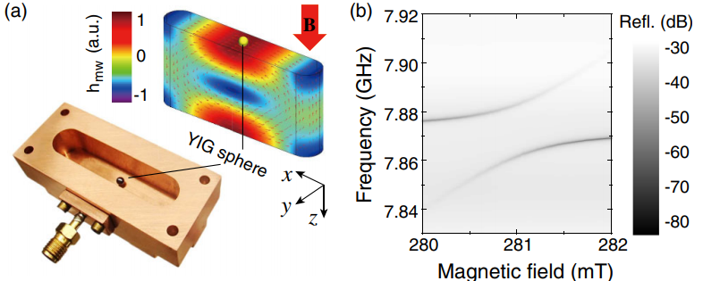

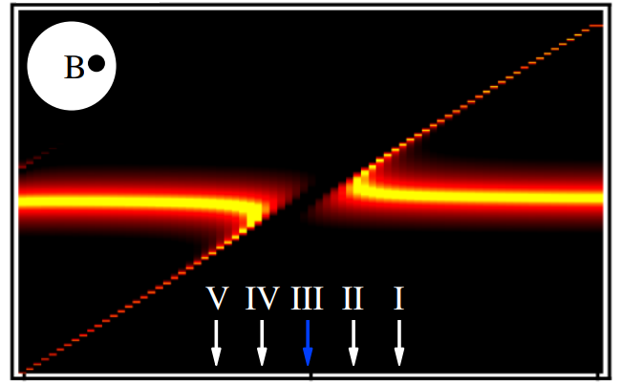
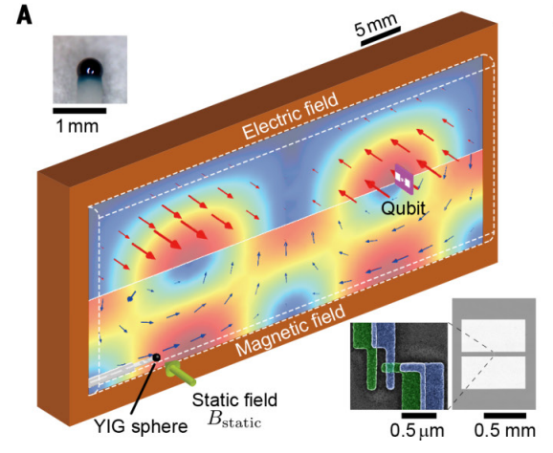
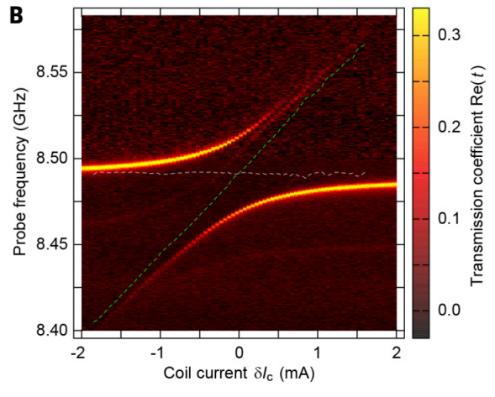
Introduction to cavity-magnon-polariton (CMP)
Coupling Mechanics of CMP
Coherent coupling
Dissipative coupling
Physical review letters 121.13 (2018): 137203.
Physical review letters 113.15 (2014): 156401.
Discovery of level attraction in CMP
Science 349.6246 (2015): 405-408.
Level repulsion has been widely studied in CMP
My research is focused on dissipative coupling.

Slide 6
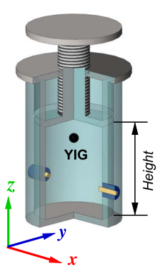
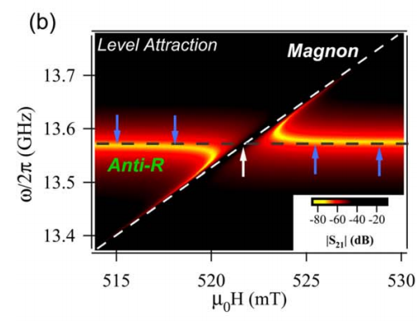
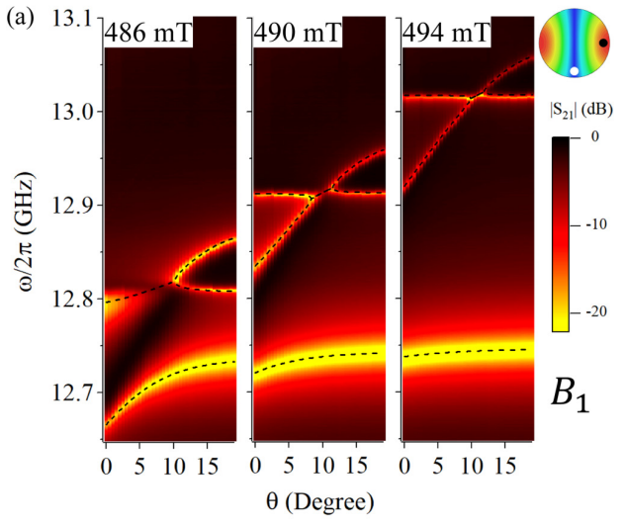
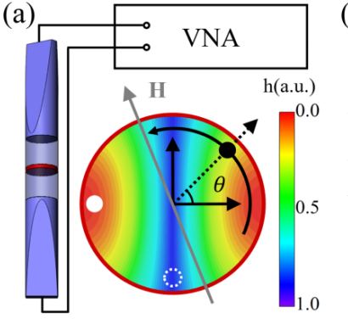
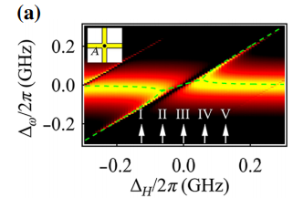
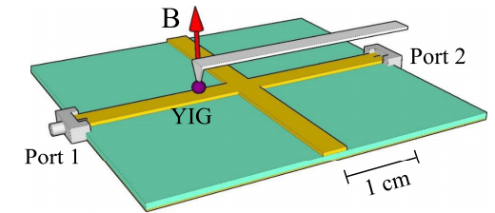
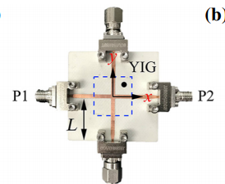
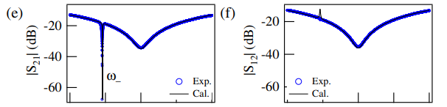
Why do we study dissipative coupling?
New Journal of Physics 21.6 (2019): 065001.
Physical Review B 100.1 (2019): 014415.
Level attraction in cavity anti-resonance
Cavity mediated level attraction
On-chip device utilizing level attraction
Nonreciprocal microwave transmission
Physical Review Applied 11.5 (2019): 054023.
Physical review letters 123.12 (2019): 127202.

Slide 7
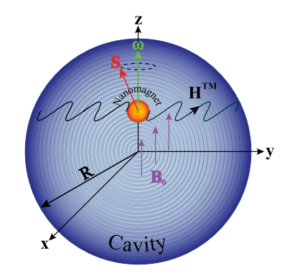
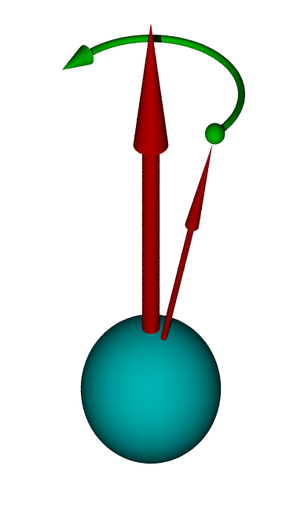
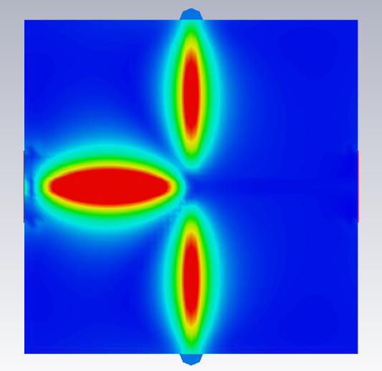
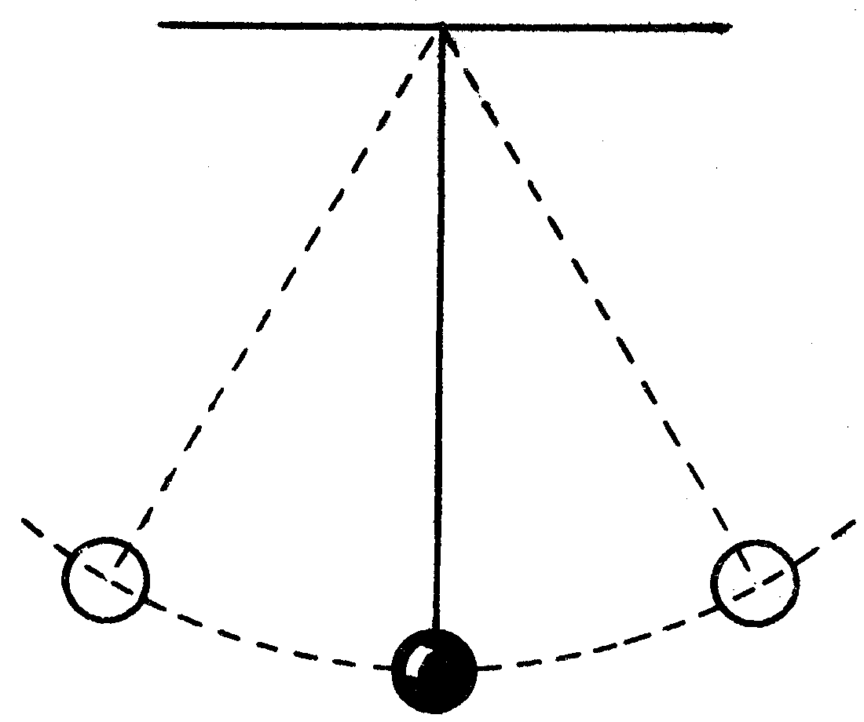

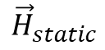
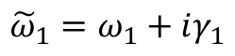
How do we understand CMP?
Coupled photon and magnon
Why do we study?
$${\vec{H}}_{static}$$
Procession
$$\vec{M}$$
Ferromagnetic resonance
Photon cavity resonance
Physical review letters 104.7 (2010): 077202.
Spin-Photon interaction.
Nanosized structural elements
Quantum information procession
…
→ Periodic motion
Complex frequency
$${\tilde{ω}}_{1}=ω_{1}+iγ_{1}$$
Resonance (real) + damping (imaginary)
Simplified to Pendulum
Notes:
Firstly, I would like to introduce the cavity magnon polariton.
Why do we study the magnon, and magnon polariton.
1 . The magnon is essential for spintronics, because the magnon is a quantized spin wave. The spintronics are different from electronics because it

Slide 8
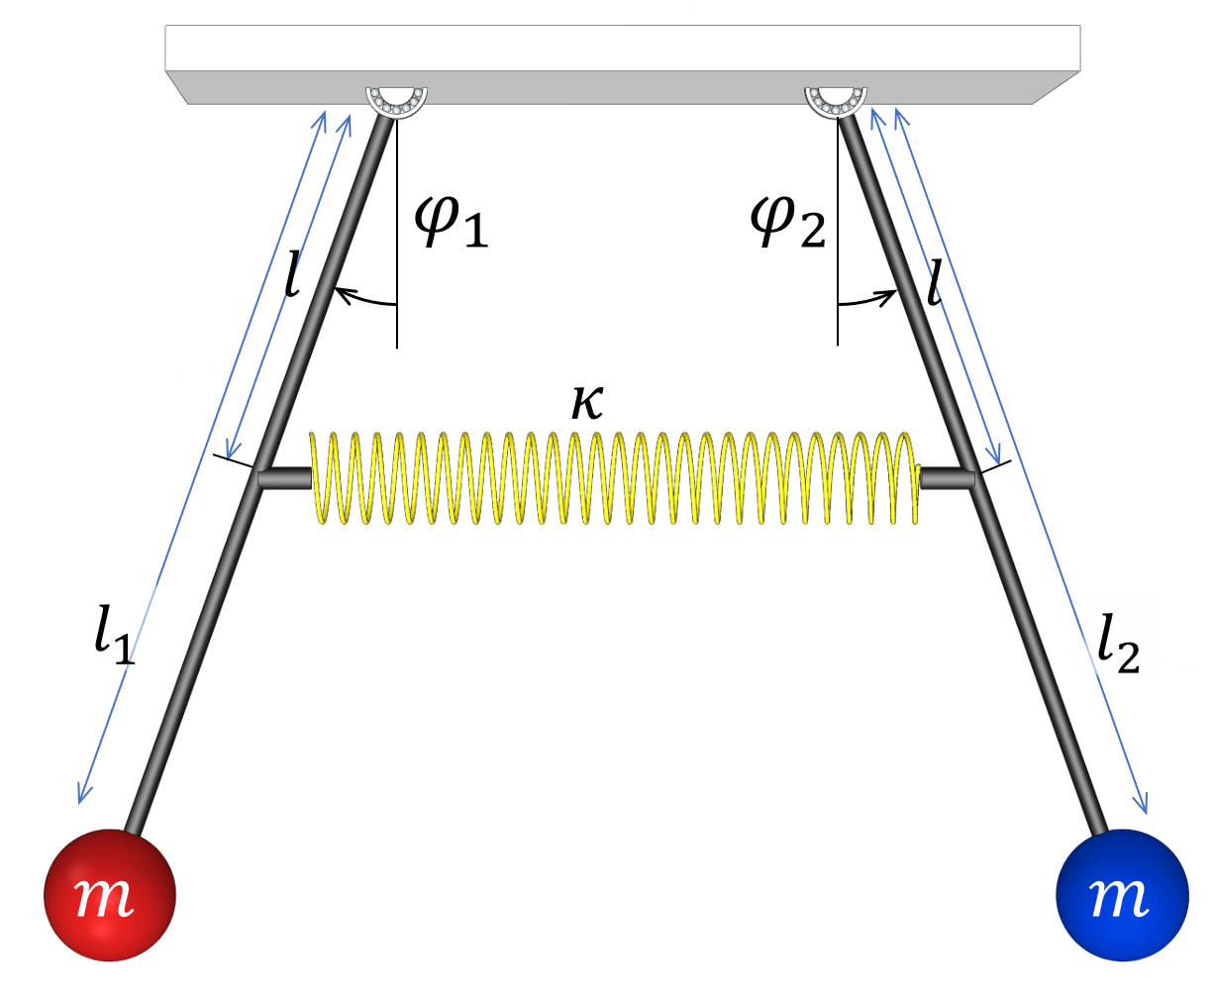
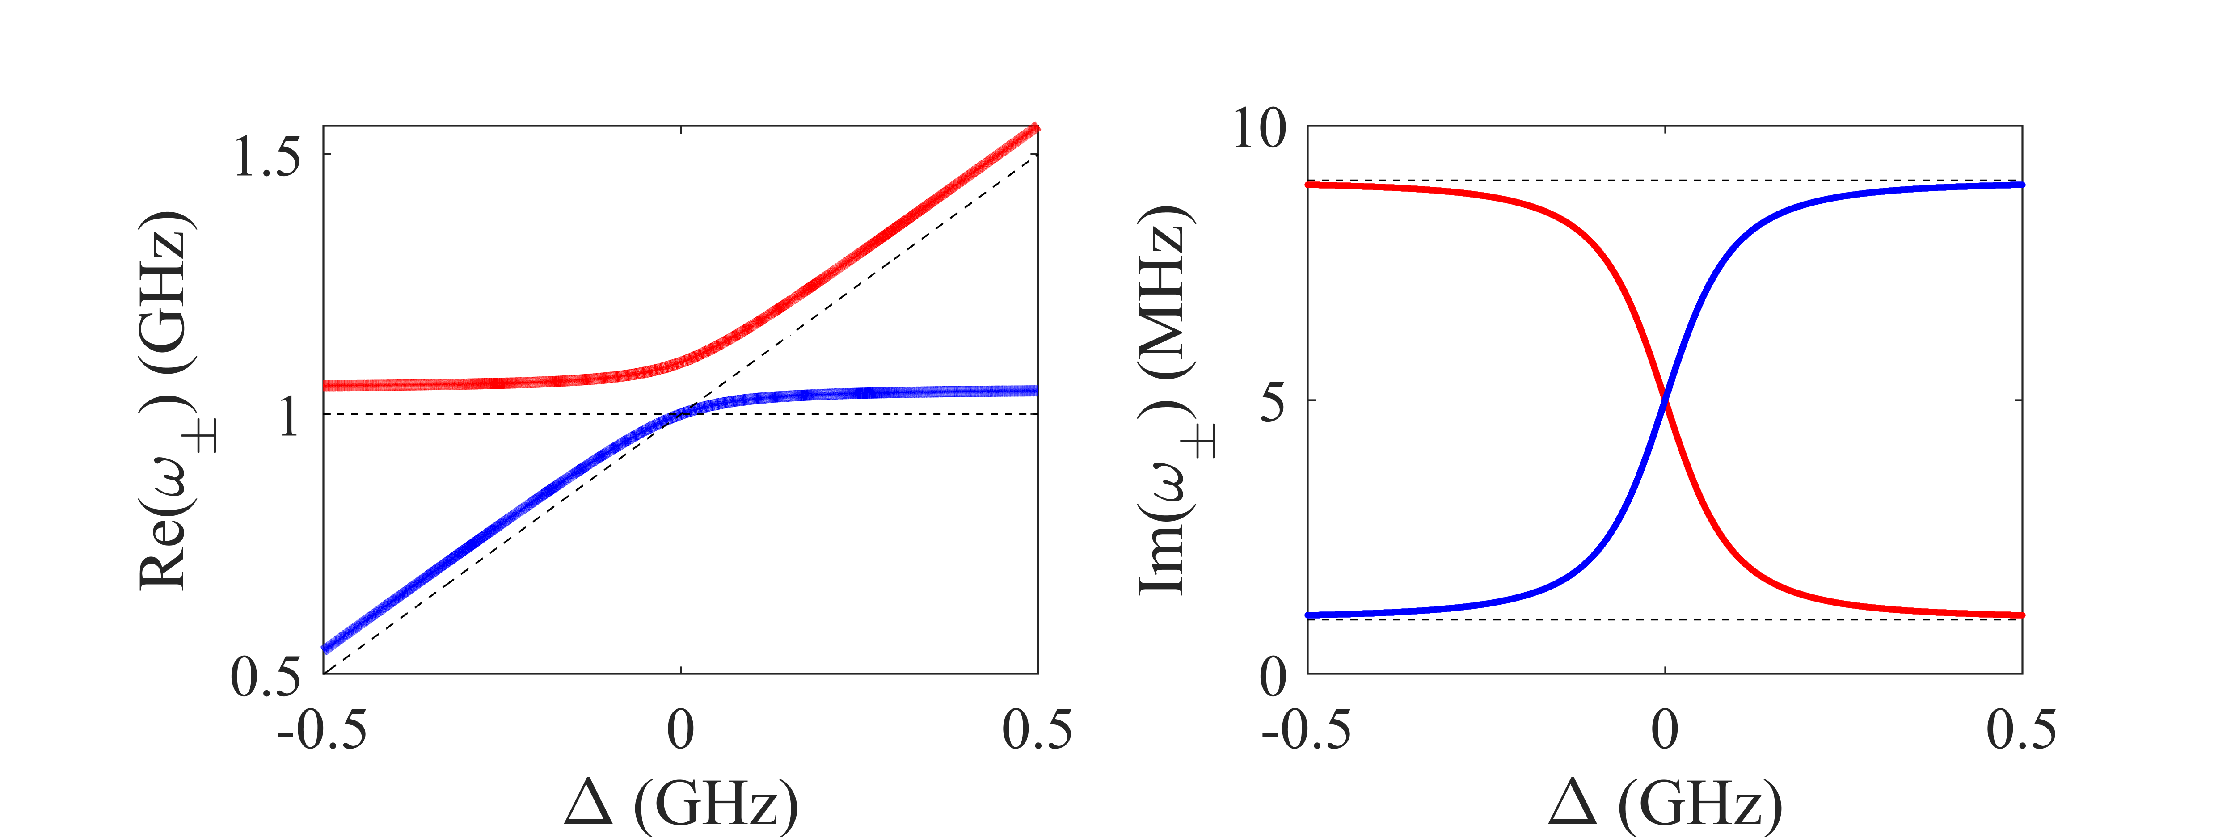
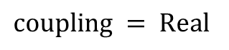

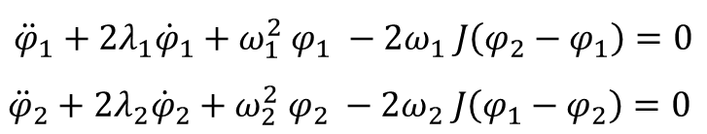
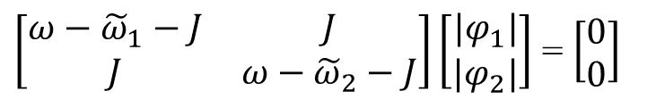
Coherent coupled pendulums
Schematic – Spring
Equation of motion:
$${\ddot{φ}}_{1}+2λ_{1}{\dot{φ}}_{1}+ω_{1}^{2} φ_{1} −2ω_{1} J\left(φ_{2}−φ_{1}\right)=0$$
$${\ddot{φ}}_{2}+2λ_{2}{\dot{φ}}_{2}+ω_{2}^{2} φ_{2} −2ω_{2} J\left(φ_{1}−φ_{2}\right)=0$$
Matrix form
$\left[\begin{matrix}ω−{\tilde{ω}}_{1}−J & J \\ J & ω−{\tilde{ω}}_{2}−J\end{matrix}\right]\left[\begin{matrix}|φ_{1}| \\ |φ_{2}|\end{matrix}\right]$ = $\left[\begin{matrix}0 \\ 0\end{matrix}\right]$
Interpretation:
$$\left[\begin{matrix}Pendulum−1 & coupling \\ coupling & Pendulum−2\end{matrix}\right]$$
$coupling = Real$
→ Conservative force

Slide 9
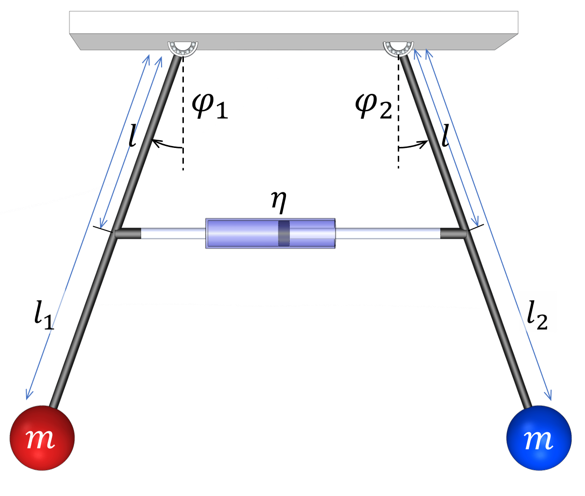
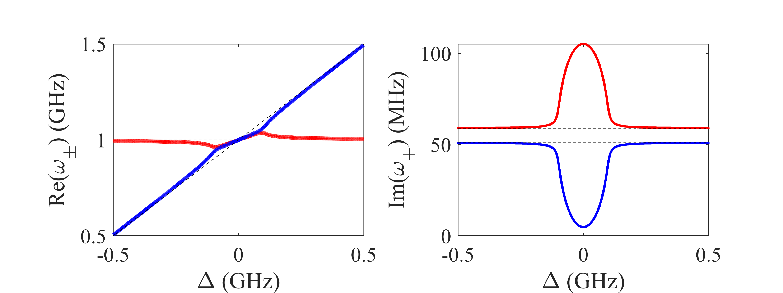


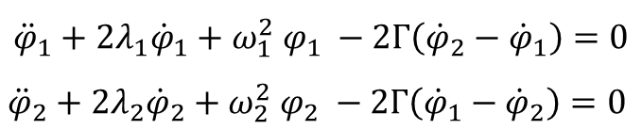
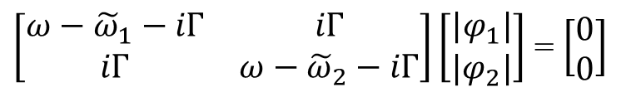
Dissipative coupled pendulums
Schematic – Dashpot
Equation of motion:
$${\ddot{φ}}_{1}+2λ_{1}{\dot{φ}}_{1}+ω_{1}^{2} φ_{1} −2Γ\left({\dot{φ}}_{2}−{\dot{φ}}_{1}\right)=0$$
$${\ddot{φ}}_{2}+2λ_{2}{\dot{φ}}_{2}+ω_{2}^{2} φ_{2} −2Γ\left({\dot{φ}}_{1}−{\dot{φ}}_{2}\right)=0$$
Matrix form
$\left[\begin{matrix}ω−{\tilde{ω}}_{1}−iΓ & iΓ \\ iΓ & ω−{\tilde{ω}}_{2}−iΓ\end{matrix}\right]\left[\begin{matrix}|φ_{1}| \\ |φ_{2}|\end{matrix}\right]$ = $\left[\begin{matrix}0 \\ 0\end{matrix}\right]$
Interpretation:
$$\left[\begin{matrix}Pendulum−1 & coupling \\ coupling & Pendulum−2\end{matrix}\right]$$
$$coupling =imaginary$$
→ Nonconservative force

Slide 10
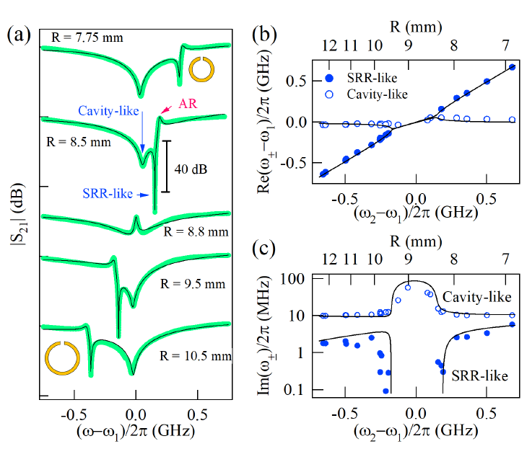
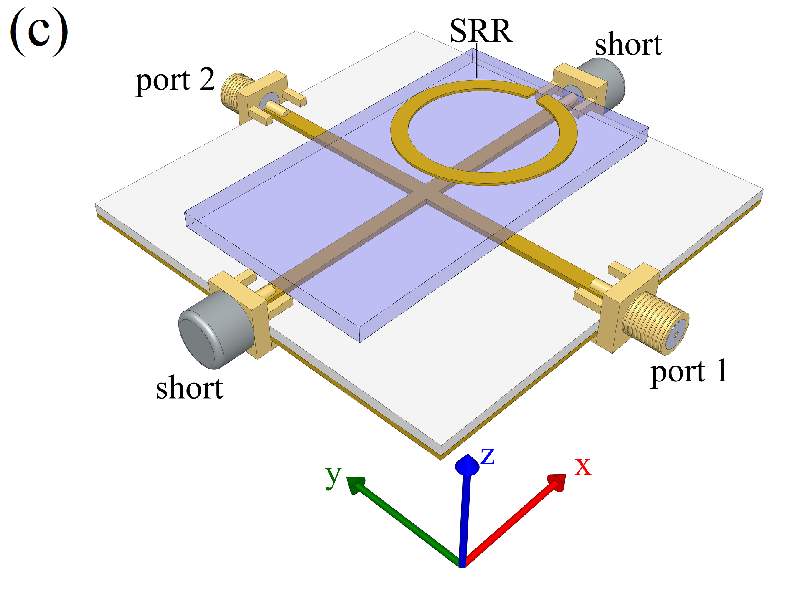
Dissipative coupling in metamaterials
Level attraction
Linewidth
Narrowing
Experiment Setup
Measured Spectra
Dispersion
Notes:
Now we introduce our first experimental work, we have used a split-ring resonator and the cross-shaped microstrip cavity to realize the dissipative coupling.
As the experiment setup shows, we placed the split ring resonator above the cross cavity, and measure the transmission of the system.
As we change the size of the split-ring, we are able to tune the resonant frequency.
The spectra was shown in figure (a) for different split-rings. As you can see from the curves, we can observe the cavity-like hybridized mode and split-ring-resonator like modes from the figure.
If we read the hybridized mode frequency, we can get the level attraction in dispersion shown in figure (b), this corresponds to the real part of the eigenvalue we calculated from theory.
Also, if we fit the linewidth of the modes, we would get the linewidth in figure (c), and this corresponds to the imaginary of the linewidth.
Notice the linewidth are shown in log scale, one of the properties in dissipative coupling is zero-damping.
We are about to utilize this property and propose practical applications for microwave devices.

Slide 11
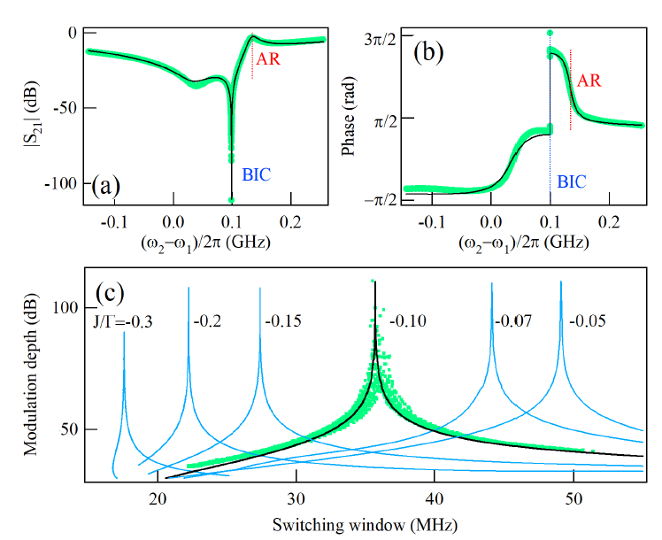
Transmission transition from 0 to 1
Asymmetry resonance is a typical Fano resonance
We have observed a transition from 0 to 1 in transmission.
1 → on
0 → off
Potential to design switching device.
ZDC
ZDC
Notes:
Figure (a) shows a typical spectrum measured near the zero damping condition, the spectrum is given by (a) shows a asymmetry behavior. This asymmetry transmission can be interpreted as Fano resonance.
The measured phase is shown in figure (b).
From the transmission, we can know the zero-damping condition is very close to the antiresonance. Where the antiresonance is related to the bare frequency of the split-ring resonator.
Our system have demonstrated the transmission from complete distinction zero to complete transmission one in a relative narrow window.
If we take the zero transmission corresponds to “off”, and transmission “1” is “on”. The narrow window bring us the potential to quickly shift from 0 to 1 or 0 to 1, which makes this device as a microwave switch.
This system have potential to design microwave switching device.

Slide 12
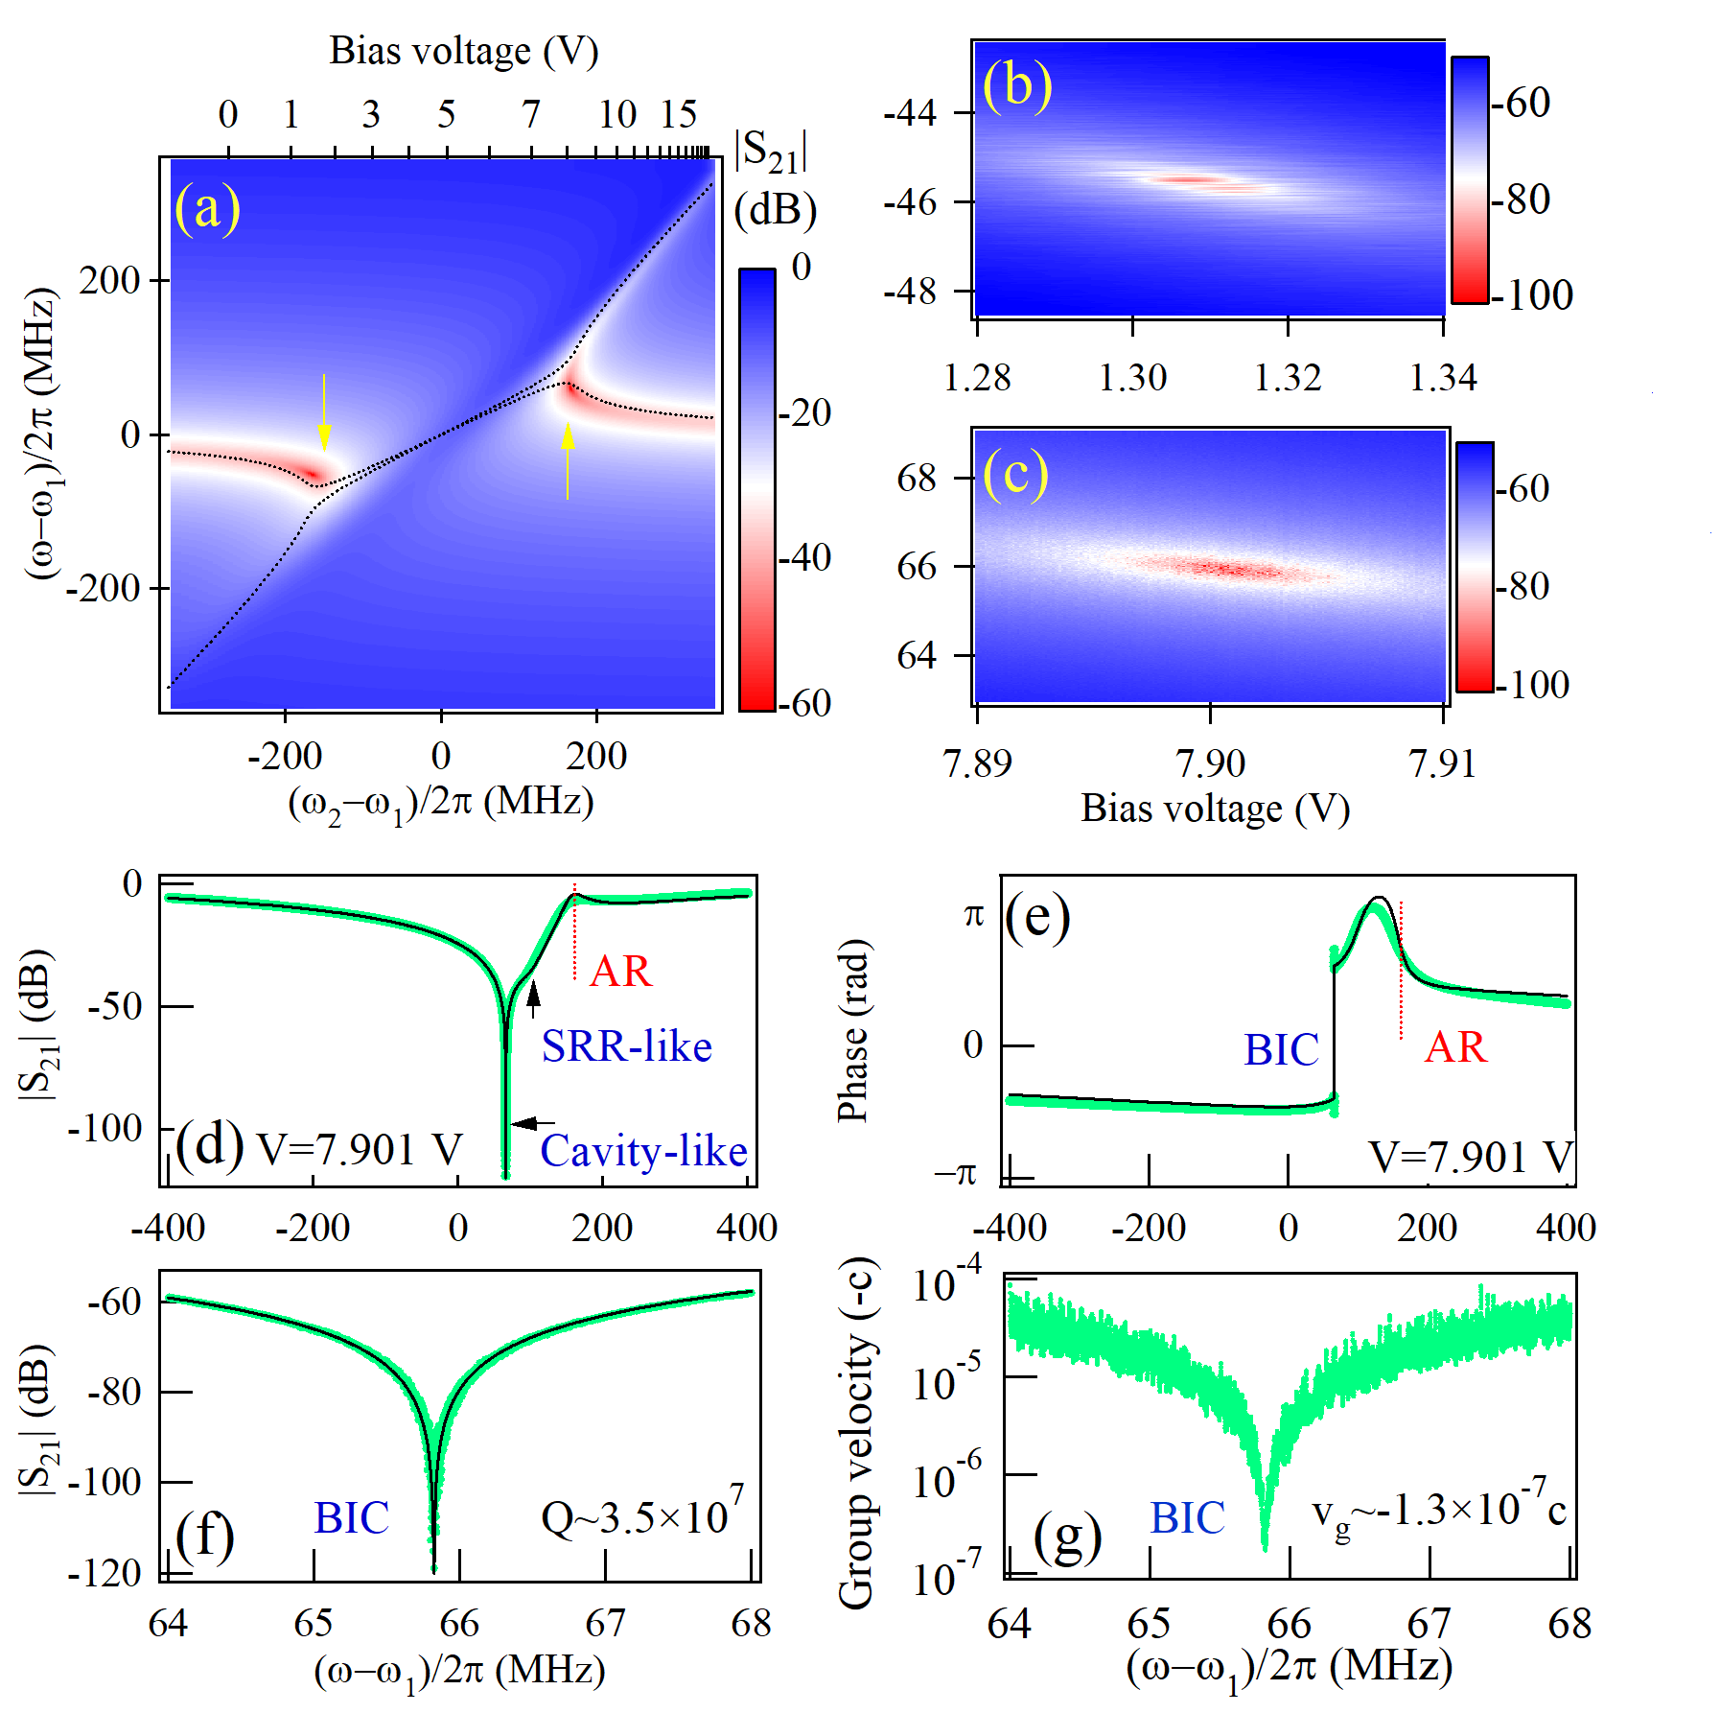
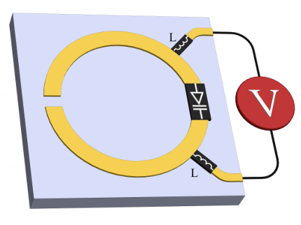
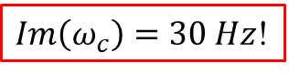
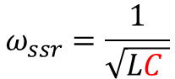
Voltage-controlled level attraction
Varactor loaded split-ring resonator
$$ω_{ssr}=\frac{1}{\sqrt{LC }}$$
(b)
(c)
$Im\left(ω_{c}\right)=30 Hz$!
Ultra-high Quality factor → sensitive detection / sensor design
Notes:
In this work, we loaded a varactor onto the split-ring resonator. Since the resonant frequency are determined by the effective inductance and capacitance. We can use the varactor diode integrated on the split-ring resonator, and use a voltage source to control the capacitance, and therefore to vary the resonant frequency of the split-ring resonator.
By using this active tunable split ring resonator, we have realized the voltage controlled level attraction shown in figure (a).
The spectrum on black arrow was shown in figure (b). From figure (b), we can see the cavity like mode is a very sharp deep. If we zoom it in we can fit this mode linewidth see figure (c). The linewidth we fitted is only 30 Hz and corresponded to a quality factor over ten to the power of 7, which higher than 30 million compare to typical several hundred in traditional planar microstrip resonator.
Such high quality factor bring a great improvement on frequency resolution and therefore offers a new approach to perform highly sensitive detection or design sensor.

Slide 13
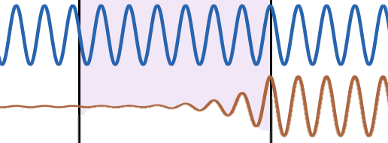
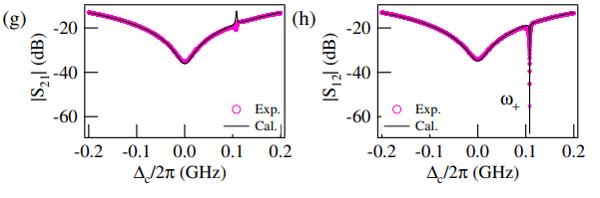
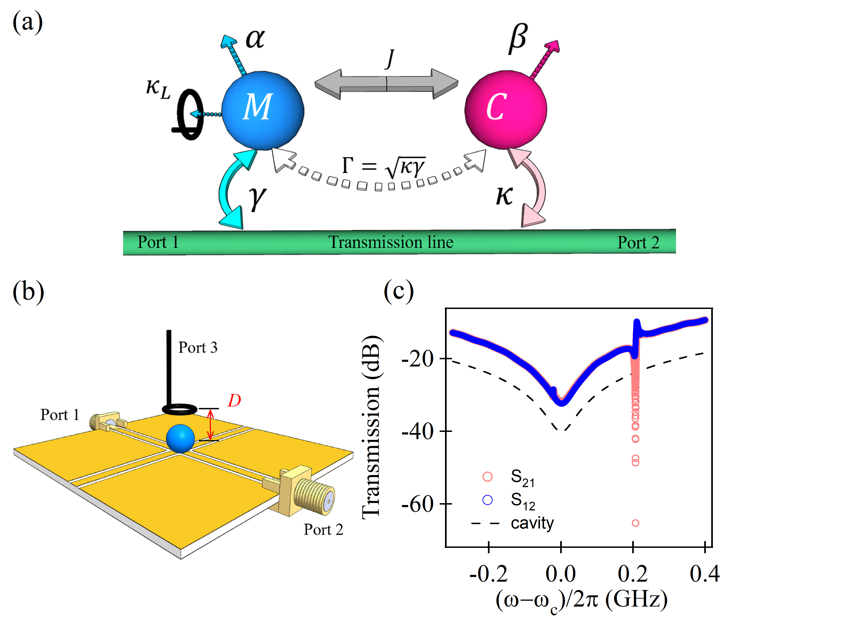
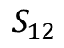
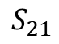
Nonreciprocity in cavity magnon polariton
Wang, Yi-Pu, et al. "Nonreciprocity and unidirectional invisibility in cavity magnonics." Physical review letters 123.12 (2019): 127202.
$$S_{21}$$
$$S_{12}$$
Unidirectional transmission
Nonreciprocal
Transmission:
Bandwidth ~ 0.5 MHz
Limited by magnon linewidth
Experiment Setup
Notes:
The nonreciprocal transmission is highly demand in quantum information procession. Especially for the quantum information storage unit – qubit. The qubits are very sensitive and even a small amount of back leakage would spoil its lifetime, and this would result the loss of quantum information. To overcome this unstable difficulties, we need the nonreciprocal device to read out the information from the qubit and at the mean time, protect the information in qubit from noisy environment.
The nonreciprocity, as the name suggests, is a signal can transmitted from one way and blocked from the other way. Which is also known as the unidirectional transmission or unidirectional invisibility. In the previous work by Dr. Wang, they has discovered the nonreciprocal phenomenon by utilizing the dissipative coupling.
From figure we took from the paper, the transmission shows a nonreciprocal behavior in the blue region.
The experiment setup was given in left-bottom corner, we used a YIG sphere to be the magnon and the cross cavity to generate photon cavity.

Slide 14
Local control of magnon damping
Intrinsic damping
Radiation damping
Experiment Setup
External damping

Slide 15
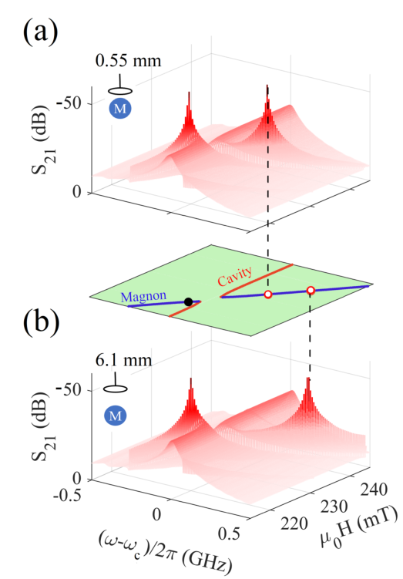
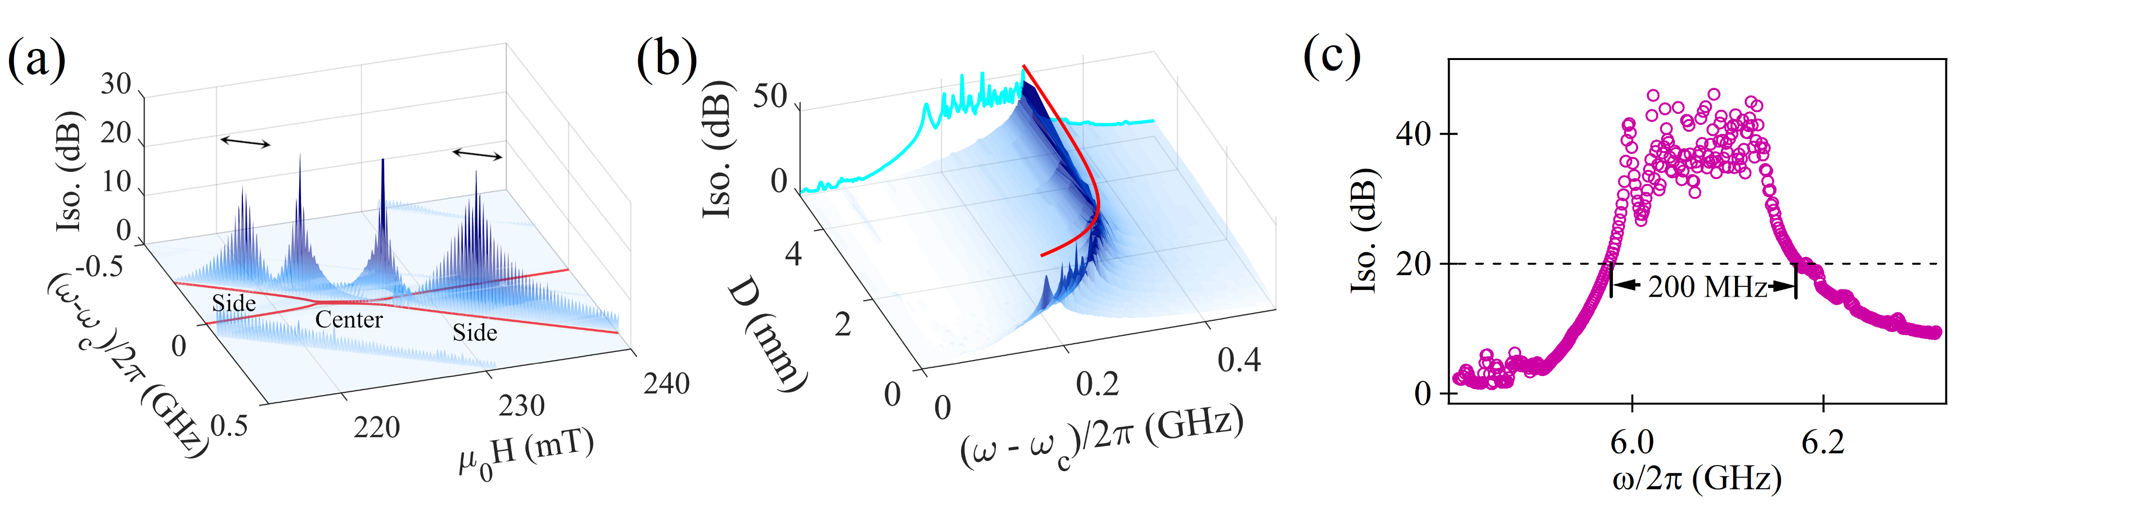
Broadband nonreciprocal device
Measured transmission
Measured transmission

Slide 16
Summary
These research explores the application of dissipative coupling in microwave frequencies.
Practical applications on sensitive detection, switch device, and broadband nonreciprocal device.
Timeline
Thesis submission
Thesis Defense
Thesis Review
Submit to Graduate Studies
Jun 15th
June-July
July-August
August 30th

Slide 17
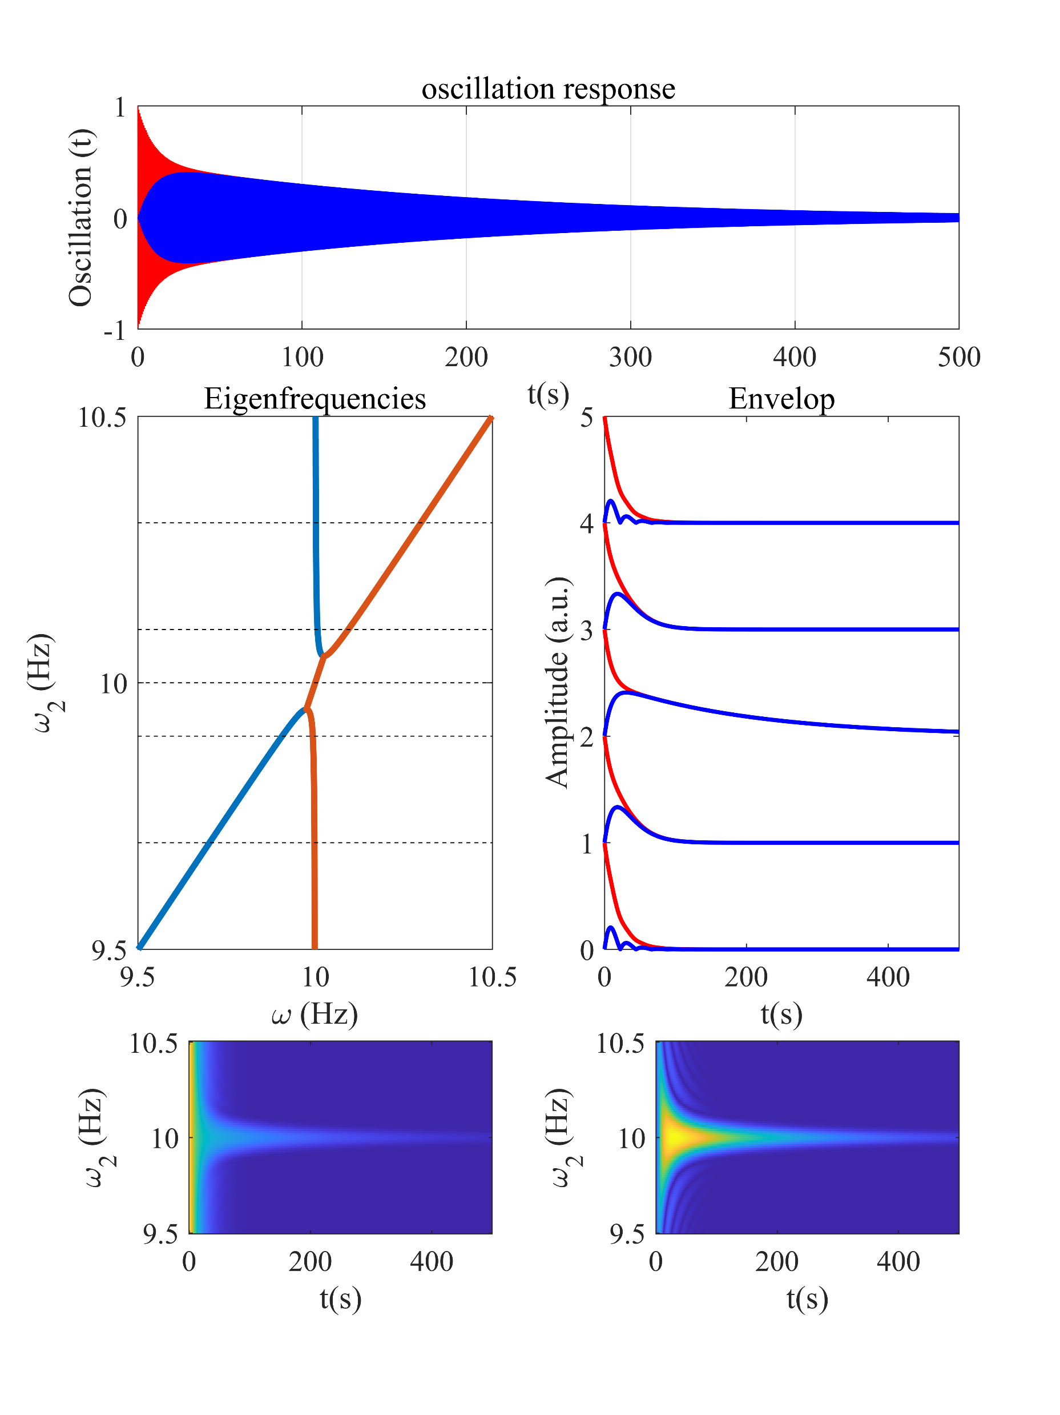
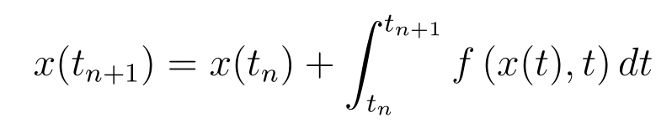
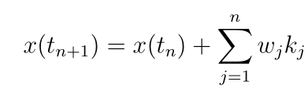
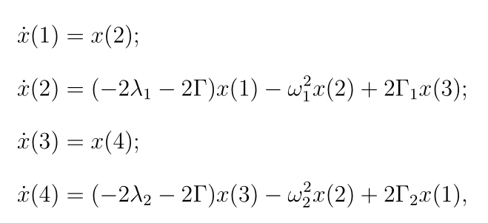
Time domain analysis
System from one moment to next moment:
Approximated solution:
Dissipative coupling as an example:

Slide 18
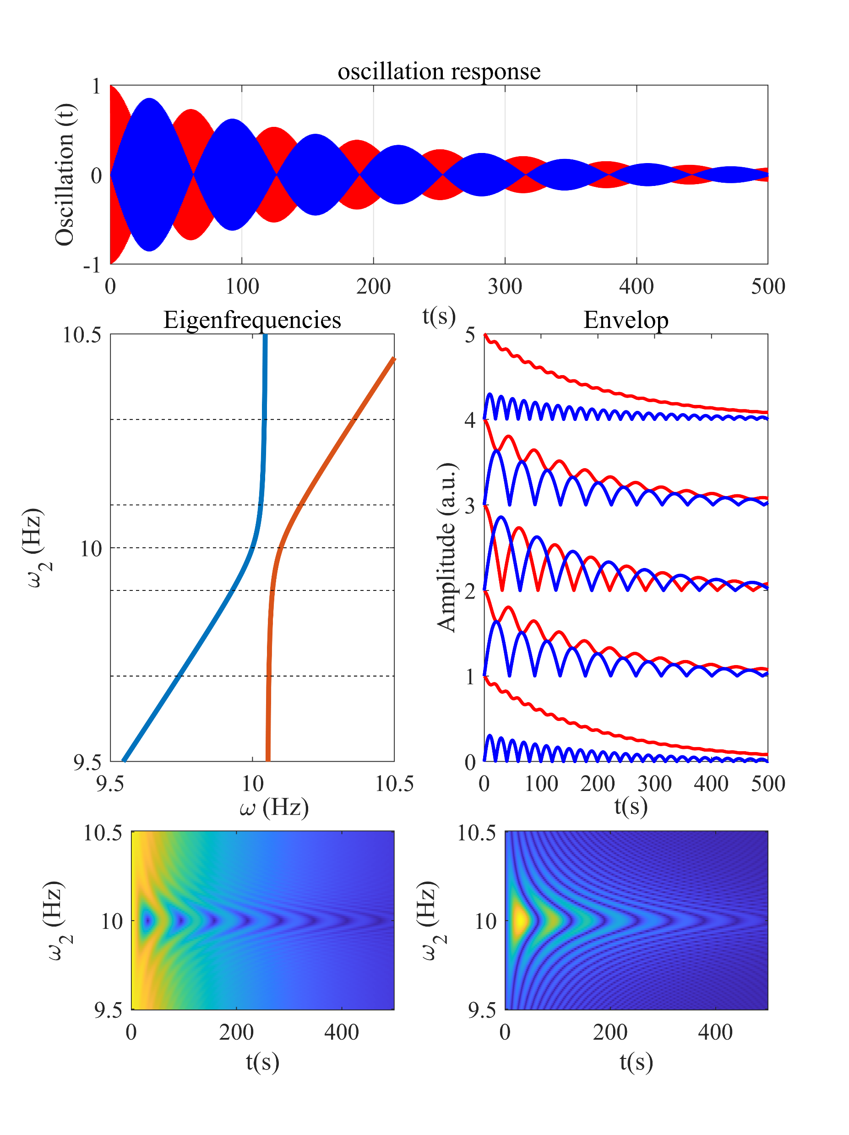
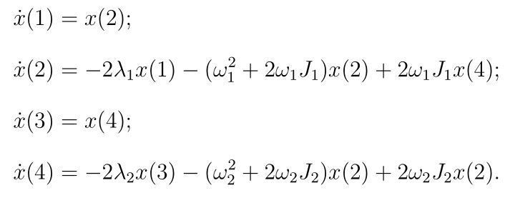
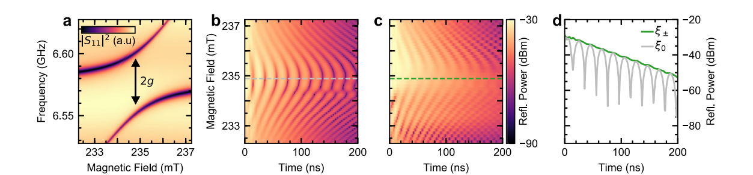
Time domain analysis (2)
Coherent coupling as another example:
[1]. Physical review letters 113.15 (2014): 156401.
[2]. Physical Review B 99.13 (2019): 134445.
[3]. Communications Physics 3.1 (2020): 1-6.

Slide 19
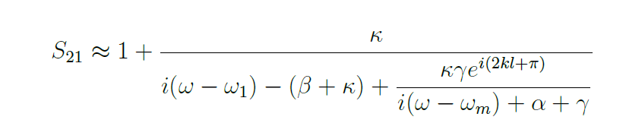
Equivalent Circuit model

Slide 20
